Slide 1
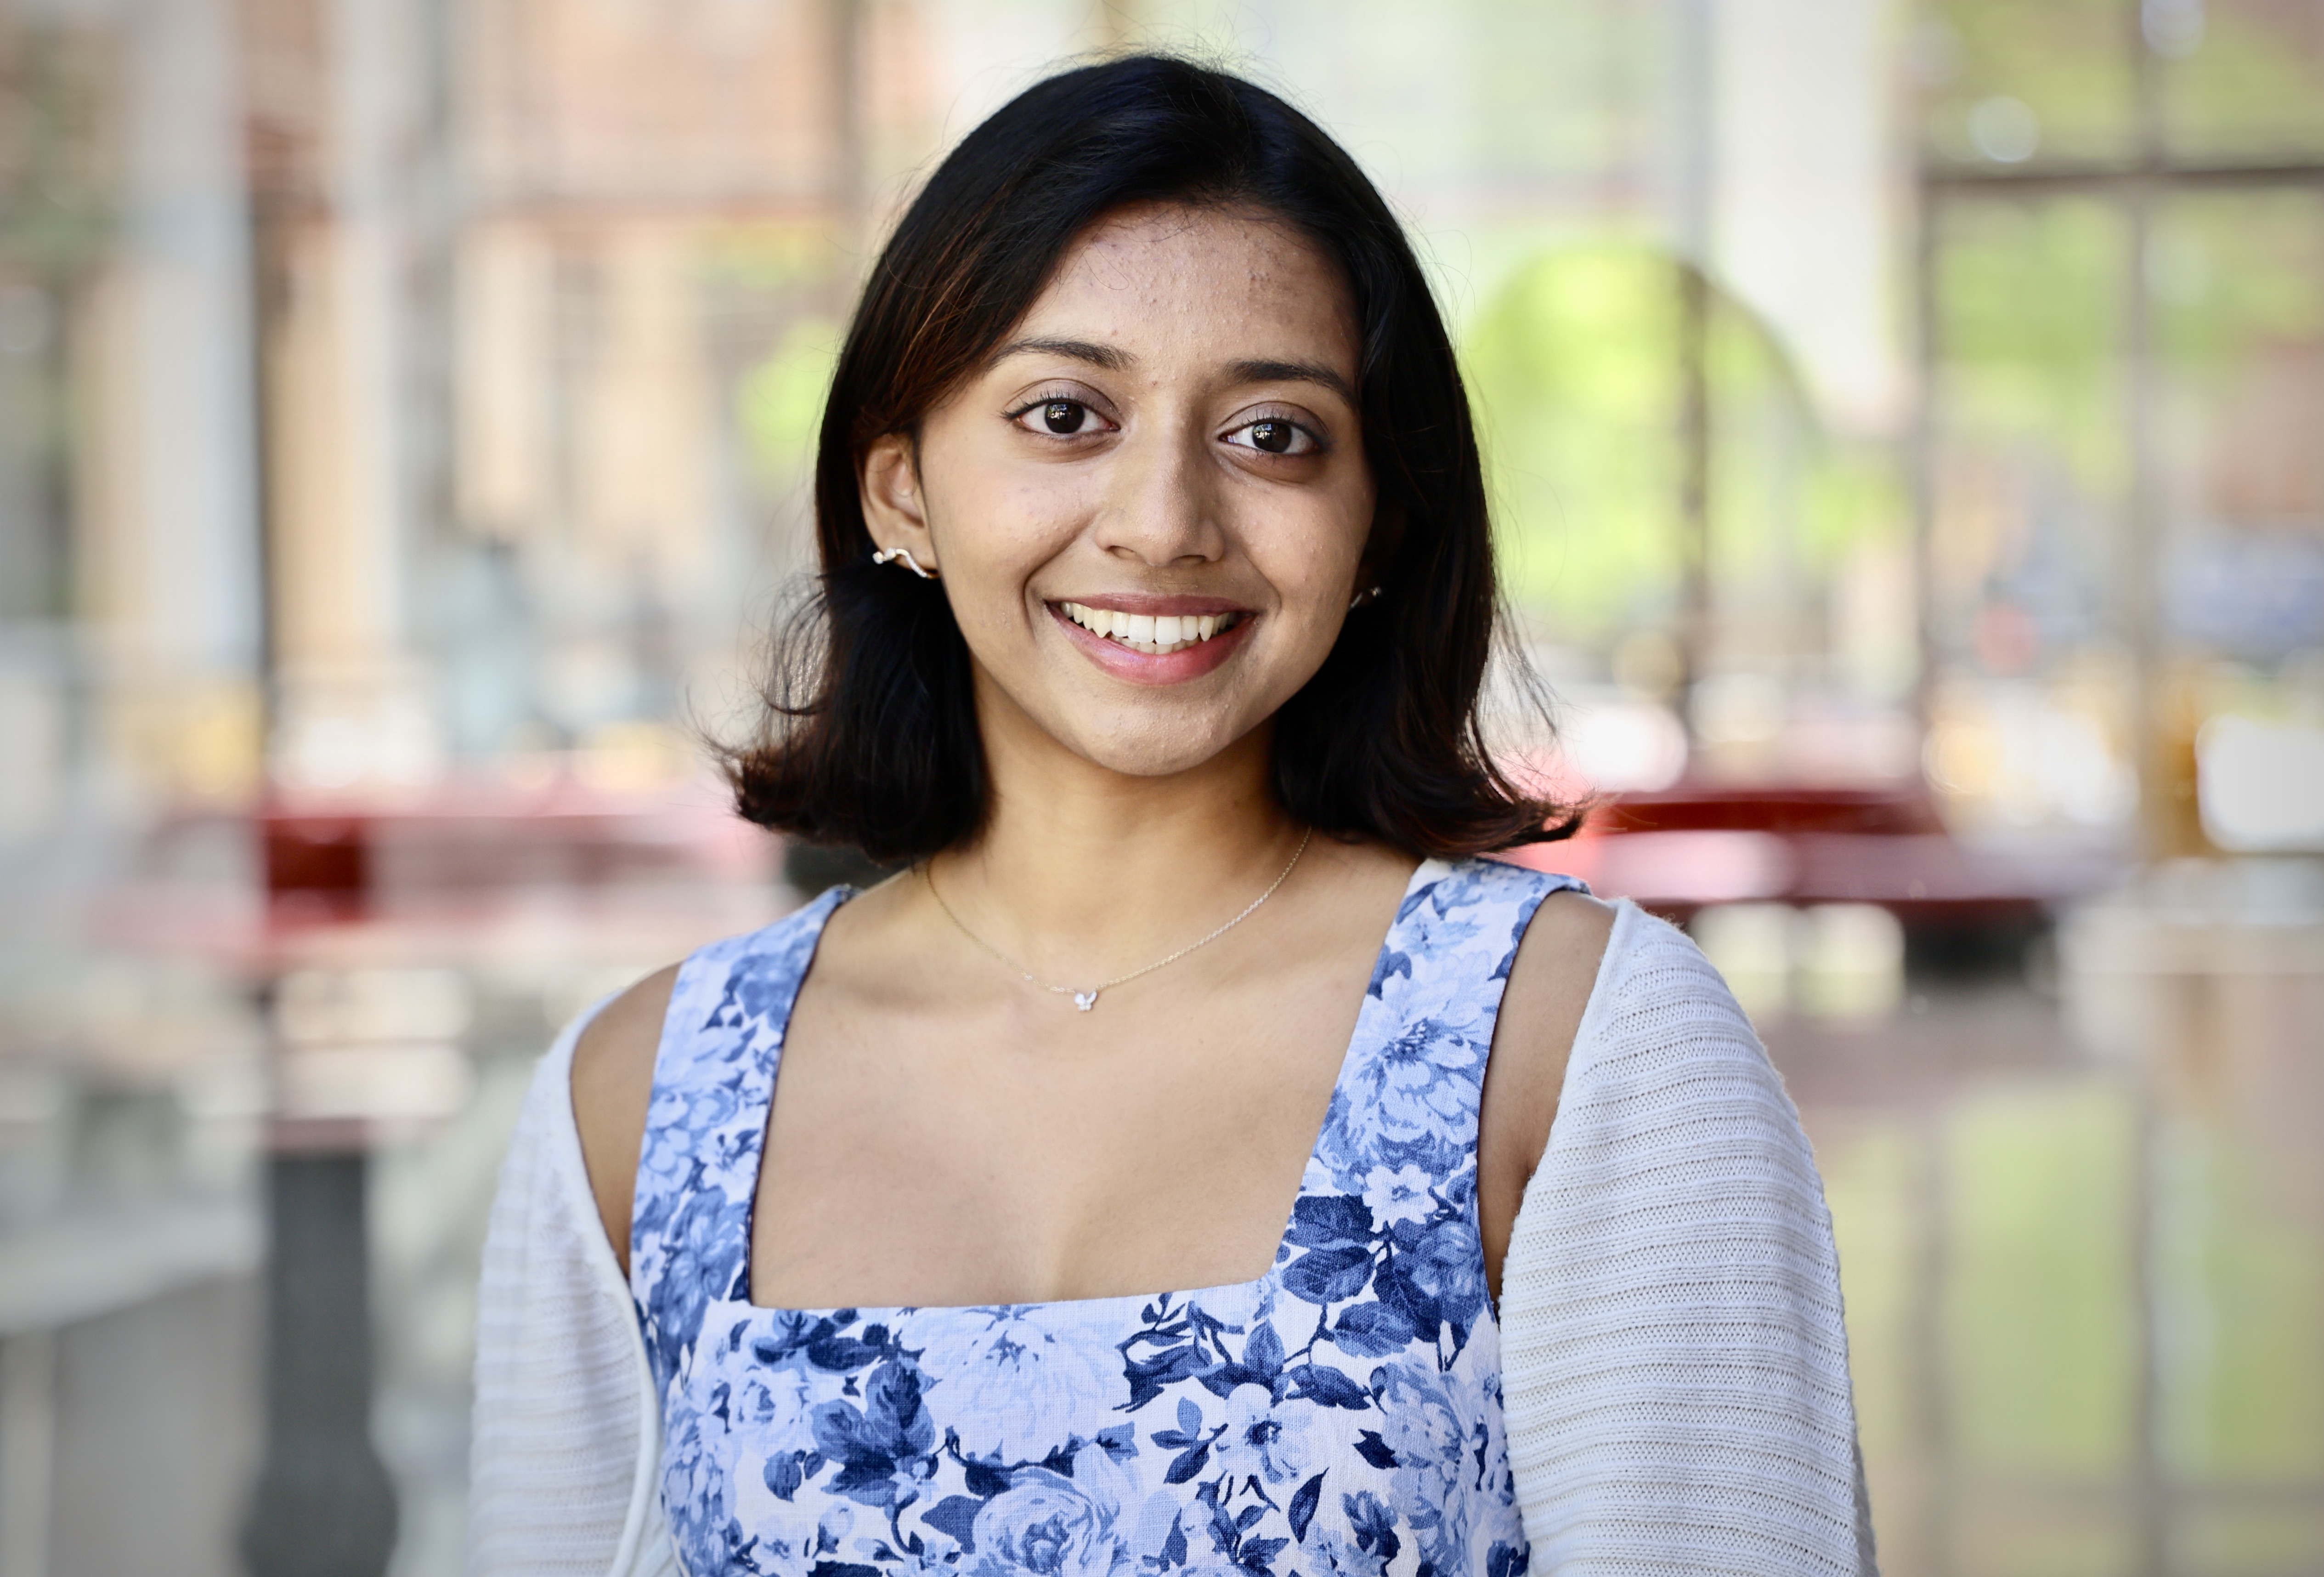

Determining the impact of intratumoral heterogeneity on the response of glioblastoma to radiotherapy planning via mathematical modeling
November 17th, 2025
Tarini Thiagarajan
3rd year PhD student, CSEM program
PhD Advisor: Dr. Thomas Yankeelov

Slide 2
Baseline mechanics workflow
Loaded patient dataset (Ex5_patient.mat).
Built mechanics matrices (mech_matrix_build_2D, grad_matrix, buildBoundaries_2D).
Ran full mechanics solver (getMechanicsMaps_2D in full mode) to generate displacement, strain, stress, and von Mises fields.

Slide 3
ROM construction
Built augmented snapshots (augmentCellMaps_2D).
Generated projection matrices (getProjectionMatrix, getDisplacementProjection_2D, getStrainProjection_2D, getStressProjection_2D).
Assembled reduced operators (M_r, Vu_gradXY_V, Ve_gradXYY_Vu, Vs_SMAT_Ve).
Ran reduced solver (get_damper_reduced) to compute ROM von Mises stress and timing.

Slide 4
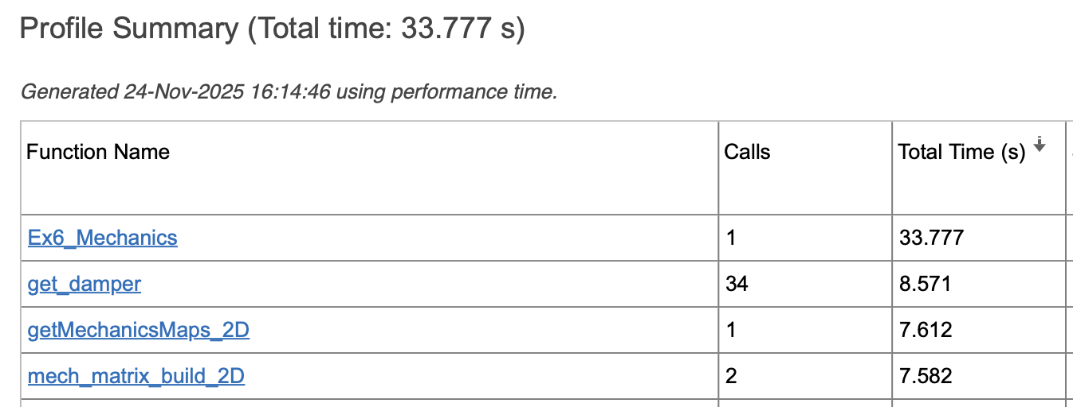
Optimization techniques
Profiler: identified bottlenecks (get_damper, mech_matrix_build_2D).
Only build the mech matrix once … save time that way
What if we only call get_damper a few times?

Slide 5
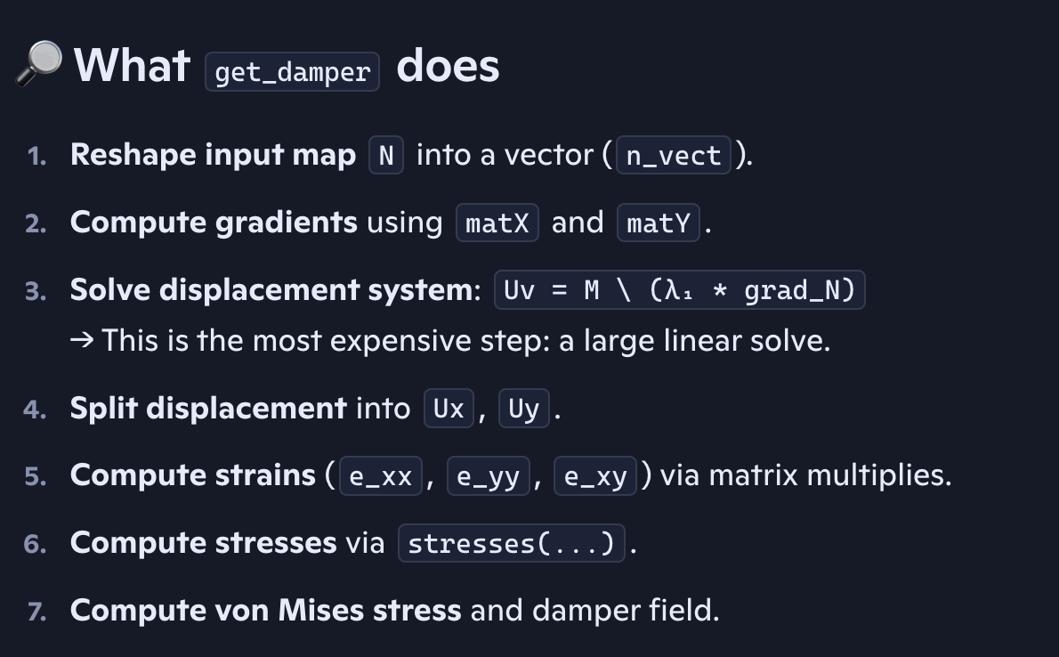
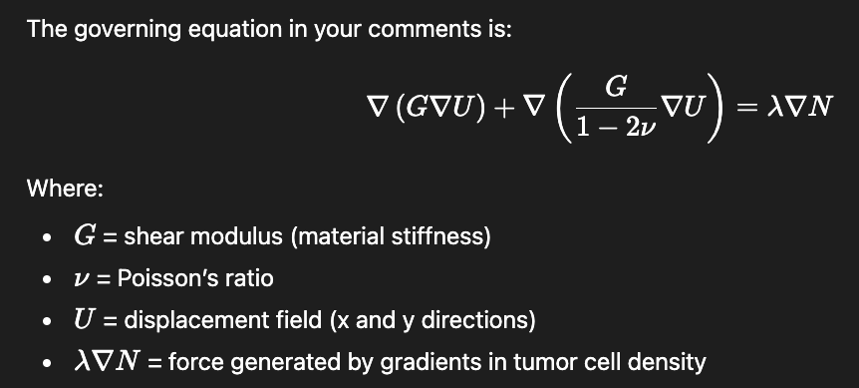
Get_damper()
get_damper is the function that solves the mechanical equilibrium equations for the tumor tissue.
Output: von mises stress
In the model, tissue is assumed to behave like a linear elastic solid, and tumor growth causes mechanical stress by pushing outward.
Notes:
Cell-pressure forcing
Mechanical load exerted by the tumor
Tissue behaves like a linear elastic solid
“Von Mises stress is a scalar measure of stress intensity, combining normal and shear components. I computed it for both the full model and the subsampled model, then calculated the relative error at each time step. This let me quantify how much accuracy I lost by skipping mechanics solves — and whether the speedup was worth it.”

Slide 6
Profiler runs (get_damper)
Ran MATLAB’s profile on … profile viewer around the main script.
Identified that get_damper and mech_matrix_build_2D consumed most of the runtime.
Used this evidence to target optimization efforts rather than guessing.
Implementation (subsampling)
Key line: “This simple stride check let me skip most calls to get_damper.”
Notes:
I used MATLAB’s profiler to measure runtime. The profiler showed that get_damper and mech_matrix_build_2D were the main bottlenecks, so we focused our optimization there.
“The profiler told me this one function was the bottleneck.”
“Since get_damper was the slowest part, I asked: do we really need to call it every single timestep?”
Explain the intuition: mechanics don’t change drastically every step, so maybe we can reuse results.
Key line: “What if I only compute it every 2 or 4 steps and reuse the last result?”

Slide 7
(get_damper) (1): results
Show the tradeoff plot (error vs speedup).
You introduced stride logic (compute every 2, 4, … timesteps instead of every step).
Result: huge speedups (up to ~2800×) but error grows with stride.
Key line: “The profiler guided me to the bottleneck, subsampling gave me huge speedups, and the error analysis justified that the approximation was acceptable.”
But how does subsampling compare to ROM implementation?
ROM: builds a reduced basis offline, then solves a smaller system online.
Notes:
“The crux of the project was using the profiler to find the slowest function, then editing that part to make the code more efficient. The error plots were just to justify that the shortcut didn’t ruin accuracy.”

Slide 8
(get_damper) (2): results
Observation:
Subsampling gave massive speedups but error climbed quickly (e.g. 4.5% at stride=4, 23% at stride=16).
ROM gave moderate speedup (418×) but much lower error (~1.3%).
This shows a tradeoff:
Subsampling = fastest, less accurate.
ROM = slower, but more accurate.
The interesting point: both methods target the same bottleneck (get_damper), but in different ways — one skips calls, the other compresses the system.
Notes:
Takeaway → “Profiler guided us to the bottleneck. Subsampling and ROM are two ways to optimize it, with different tradeoffs between speed and accuracy.”

Slide 9
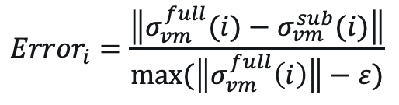
$${Error}_{i}=\frac{\left\|σ_{vm}^{full}(i)−σ_{vm}^{sub}(i)\right\|}{max⁡(\left\|σ_{vm}^{full}\left(i\right)\right\|−ε)}$$
Notes:
“This plot shows the tradeoff: subsampling is faster, ROM is more accurate. The choice depends on how much error you can tolerate.”
Where:
∥⋅∥\|\cdot\| is the vector norm over all grid points
ε=10−12\varepsilon = 10^{-12} is a small number to avoid division by zero
You computed this for each time step i, then averaged across all steps

Slide 10
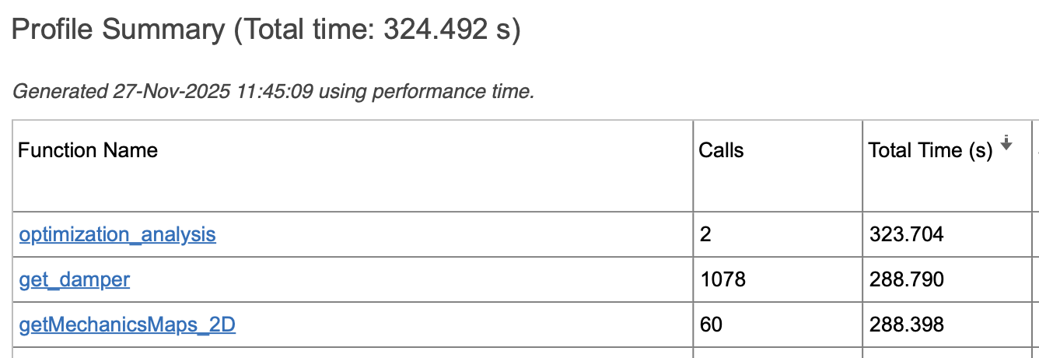
Optimization techniques
Profiler: identified bottlenecks (get_damper, mech_matrix_build_2D)
I already implemented subsampling as the first optimization method. The updated profiler confirms that the bottleneck (get_damper) is still dominating runtime → the next optimization method should target how get_damper itself is executed, not just how often.
reduce the cost per call of get_damper.
Notes:
This is with a different set of code so don’t worry about the previous numbers for timings.. We are not comparing performance from baseline since the code is not the exact same… I am calling a bunch of fthings in the new script not just once like the first example script. That was just a baseline thing.

Slide 11
Optimization techniques
Profiler: Identify bottlenecks (get_damper, mech_matrix_build_2D)
Optimization method 1: Reduce number of calls if possible
Only build the mechanical matrix once
Subsampling (stride logic) – choose stride of 4 (beyond that, error grows quickly)
Optimization method 2: Reduce reduce the cost per call of get_damper (vectorization, batching, or parallelization).
Notes:
This is with a different set of code so don’t worry about the previous numbers for timings.. We are not comparing performance from baseline since the code is not the exact same… I am calling a bunch of fthings in the new script not just once like the first example script. That was just a baseline thing.

Slide 12
(get_damper) (3)
Uv = M\(lambda1*grad_N);
When you solve M \ rhs in MATLAB, it does two steps:
Factorize M (the heavy part: break the matrix into LU pieces).
Solve using those factors (the light part: forward/back substitution).
Where the cost is: The linear solve M \ (...) dominates. Every timestep, MATLAB is solving a big system from scratch.
MATLAB has to factorize the big matrix M (break it into pieces so it can solve the system). Factorization is expensive. Doing it hundreds of times is why get_damper eats so much time.
Right now, every call to get_damper repeats step 1 and step 2.
To optimize, let’s do step 1 once, store the LU factors, and reuse them for every timestep.
Notes:
In your get_damper, the only truly heavy operation is Uv = M \ (λ₁ * grad_N).
Everything else (reshape, matX*vector, stresses) are just matrix–vector multiplies or elementwise operations, which MATLAB handles very quickly.
The profiler output you shared shows get_damper consuming ~286 s self‑time out of ~289 s total. That means almost all of its time is inside its own body, not in sub‑functions.
Given the code, the only candidate for that much cost is the repeated factorization/solve of M.

Slide 13
(get_damper) (3)
Uv = M\(lambda1*grad_N);
Section 1 (original get_damper, stride=4) runtime: 0.000181 s
Section 2 (cached LU get_damper, stride=4) runtime: 0.000063 s
Speedup factor: 2.86
Method | Runtime (s) | Speedup | VM Error (%)
FOM full (stride=1) | 324.000 | 1× | 0
FOM (stride=4) | 0.114 | 2850× | 4.5
FOM (stride=4 + LU once) | 0.040 | 8100× | 4.5
ROM baseline | 0.774 | 418× | 1.3
Notes:
Emphasize that LU caching doesn’t change accuracy (error stays ~4.5%), but it makes each subsampled solve ~3× faster.
ROM: Lower error, but slower than optimized FOM.
The error is identical bc: Same math, same inputs: LU caching doesn’t change the linear system you solve. If MM and the right‑hand side are identical, the solution from a cached LU and a fresh solve are mathematically the same. You’re just reusing the factorization to avoid recomputing it.

Slide 14
Optimization techniques
Profiler: Identify bottlenecks (get_damper, mech_matrix_build_2D)
Optimization method 1: Subsampling (stride=4) gave ~2800× speedup with ~4.5% error.
Optimization method 2: Solving LU once reduced per‑call cost by ~3×, compounding the benefit of subsampling.
Used lu() function (an external, optimized linear‑algebra library) instead of a simple backslash (Uses MATLAB’s LAPACK/BLAS for optimized linear algebra.)

Slide 16
Motivations
The therapeutic effect of radiation has been shown to be related to tissue oxygenation and the proliferation rate of the cells.
Problem:
However, RT planning typically assumes homogenous efficacy across the tumor, which can lead to an overestimation of tumor cell death and control.
Goal:
We seek to quantify this overestimation by calculating the local dose boost required by non-homogeneous RT efficacy models to achieve a predefined target surviving fraction (SF_{target}).
Notes:
SF_{target} represents the biological effect following a spatially uniform 2 Gy/fraction dose across the tumor
Goal: Investigate how model selection and tumor response dynamics influence optimal dose distribution + the identify which biological mechanisms of radioresistance if at all may dominate in each patient

Slide 17
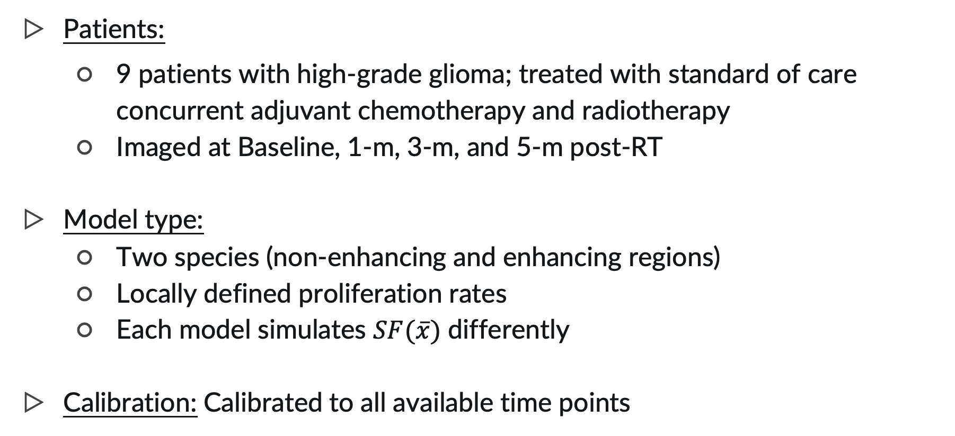
Data summary
Patients:
9 patients with high-grade glioma; treated with standard of care concurrent adjuvant chemotherapy and radiotherapy
Imaged at Baseline, 1-m, 3-m, and 5-m post-RT
Model type:
Two species (non-enhancing and enhancing regions)
Locally defined proliferation rates
Each model simulates $SF(\overline{x})$ differently
Calibration: Calibrated to all available time points
Hormuth et al. Sci Rep 11, 8520, 2021
Notes:
The initial RT treatment phase consisted of 30 fractions of 2 Gy administered on weekdays for 6 weeks for a total of 60 Gray (Gy), with concurrent 75 mg/m² of daily oral temozolomide.
The subsequent adjuvant phase consisted of a minimum of six 28-day cycles of temozolomide delivered at 150-200 mg/m² on the first five days of each cycle.

Slide 18
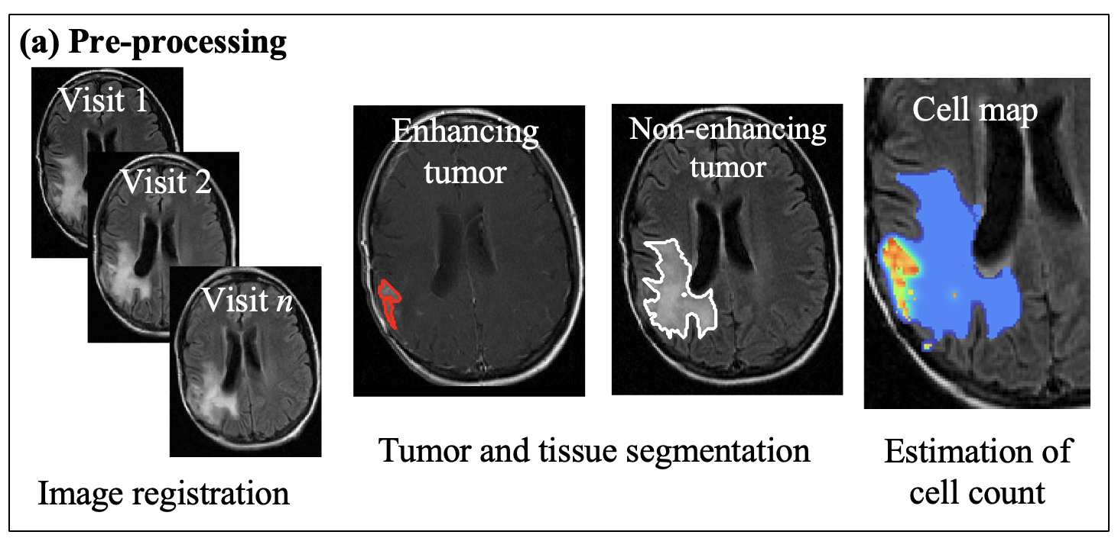
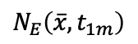
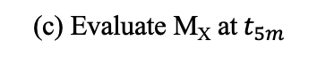
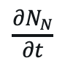
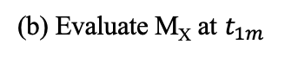
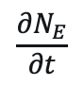
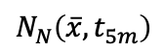
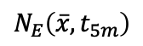
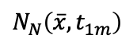
1
Image processing
Tumor volume fraction
0
Project flowchart
Baseline; t₀
1-month
post-RT; t_{1m}
5-months
post-RT; t_{5m}
Measured
Calibrate models for patients
(d)
(a)
Tumor growth & response parameters
Assess error between M_{X} and measurement
$$\frac{∂N_{E}}{∂t}$$
$$N_{E}\left(\overline{x},t_{1m}\right)$$
$$N_{E}\left(\overline{x},t_{5m}\right)$$
$$\frac{∂N_{N}}{∂t}$$
(b) Evaluate M_{X} at $t_{1m}$
$$N_{N}\left(\overline{x},t_{1m}\right)$$
(c) Evaluate M_{X} at${ t}_{5m}$
$$N_{N}\left(\overline{x},t_{5m}\right)$$
Notes:
We calibrated for 10 params (we have 22 in all)
Nb,k
Nb,Dw (uninhibited)
Nb, Dg (uninhibited)
SF_RT
SF_other (chemo outside of RT)
SF_ct (chemo during RT)
Mechanical coupling (von mises lambda)
Na, proliferation scaling
Na, diffusion scaling (Scaling factor for diffusion coefficient Da = params_e(7)*Db)
RT_long (long term effect of RT)

Slide 19
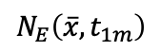
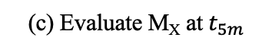
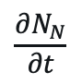
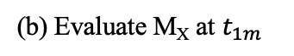
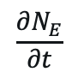
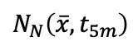
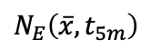
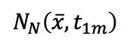
Baseline; t₀
1-month
post-RT; t_{1m}
5-months
post-RT; t_{5m}
Measured
Calibrate models for patients
(d)
(a)
Tumor growth & response parameters
Assess error between M_{X} and measurement
$$\frac{∂N_{E}}{∂t}$$
$$N_{E}\left(\overline{x},t_{1m}\right)$$
$$N_{E}\left(\overline{x},t_{5m}\right)$$
$$\frac{∂N_{N}}{∂t}$$
(b) Evaluate M_{X} at $t_{1m}$
$$N_{N}\left(\overline{x},t_{1m}\right)$$
(c) Evaluate M_{X} at${ t}_{5m}$
$$N_{N}\left(\overline{x},t_{5m}\right)$$
Project flowchart
Post-RT in silico experiments
homogeneous
heterogeneous
1
M_{H}
M_{V}
M_{CD}
Response assessment
Calculate percent change in tumor cell count as a function of different assumptions of treatment efficacy.
Post-calibration processing
or
or
Tumor volume fraction
Calibrated parameters are used to forecast tumor response given the assumption on treatment efficacy and surviving fraction.
0

Slide 20
Baseline; t₀
1-month
post-RT; t_{1m}
5-months
post-RT; t_{5m}
Measured
Calibrate models for patients
(d)
(a)
Tumor growth & response parameters
Assess error between M_{X} and measurement
$$\frac{∂N_{E}}{∂t}$$
$$N_{E}\left(\overline{x},t_{1m}\right)$$
$$N_{E}\left(\overline{x},t_{5m}\right)$$
$$\frac{∂N_{N}}{∂t}$$
(b) Evaluate M_{X} at $t_{1m}$
$$N_{N}\left(\overline{x},t_{1m}\right)$$
(c) Evaluate M_{X} at${ t}_{5m}$
$$N_{N}\left(\overline{x},t_{5m}\right)$$
Project flowchart
Post-RT in silico experiments
homogeneous
heterogeneous
1
M_{H}
M_{V}
M_{CD}
Response assessment
Calculate percent change in tumor cell count as a function of different assumptions of treatment efficacy.
Post-calibration processing
or
or
Tumor volume fraction
Calibrated parameters are used to forecast tumor response given the assumption on treatment efficacy and surviving fraction.
0

Slide 21
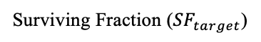
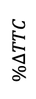
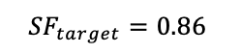
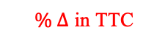
$${SF}_{target}=0.86$$
M_{H}
Project flowchart
Start of RT
TTC (cells)
$$\%∆TTC$$
Response assessment
$\% ∆$ in TTC
End of RT
Time (days)
Surviving Fraction (${SF}_{target}$)

Slide 22
Post-RT in silico experiments
homogeneous
heterogeneous
1
M_{H}
M_{V}
M_{CD}
Response assessment
Calculate percent change in tumor cell count as a function of different assumptions of treatment efficacy.
Post-calibration processing
or
or
Tumor volume fraction
Calibrated parameters are used to forecast tumor response given the assumption on treatment efficacy and surviving fraction.
0
Project flowchart
Dose calculation
Model comparison
M_{H}
M_{V}
M_{CD}
Quantify differences in individual dose plans between best-fit model and the alternatives.
M_{V}
M_{CD}
Dose personalization
Model selection
0.50
0.32
0.18
0
5.2
Gy/fraction
w_{i}
Within the CTV, determine the dose map required for optimal outcomes.
Select model with highest AIC-weights (w_{i}) between model and measurement for each patient.

Slide 23
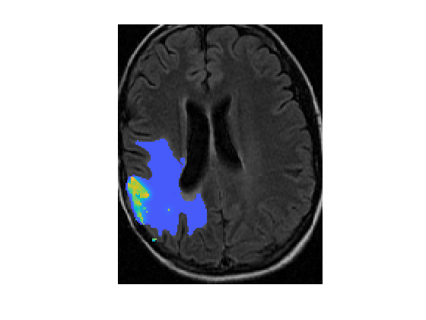
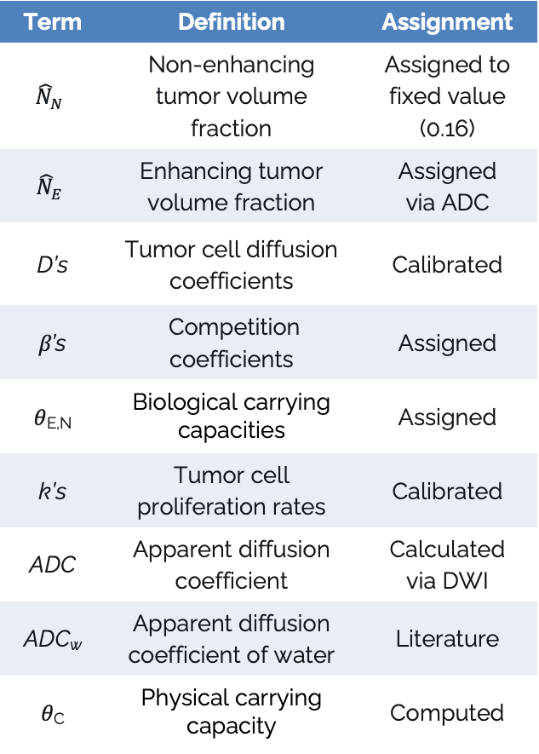
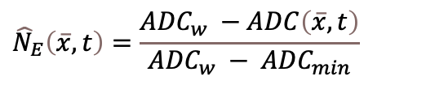
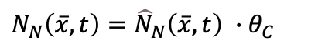
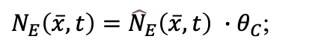
Mathematical modeling
of tumor growth
Term | Definition | Assignment
$${\hat{N}}_{N}$$ | Non-enhancing tumor volume fraction | Assigned to fixed value (0.16)
$${\hat{N}}_{E}$$ | Enhancing tumor volume fraction | Assigned via ADC
D’s | Tumor cell diffusion coefficients | Calibrated
β’s | Competition coefficients | Assigned
𝜃_{E,N} | Biological carrying capacities | Assigned
k’s | Tumor cell proliferation rates | Calibrated
ADC | Apparent diffusion coefficient | Calculated via DWI
ADC_{w} | Apparent diffusion coefficient of water | Literature
𝜃_{C} | Physical carrying capacity | Computed
Two species mathematical model of tumor growth
Enhancing tumor volume fraction (via T1+C)
$$\frac{∂{\hat{N}}_{E}\left(\overline{x},t\right)}{∂t}=∇∙\left(D_{E}\left(\overline{x},t\right)∇{\hat{N}}_{E}\left(\overline{x},t\right)\right)+k_{p,E}\left(\overline{x},t\right){\hat{N}}_{E}\left(\overline{x},t\right)\left(1−\frac{{\hat{N}}_{E}\left(\overline{x},t\right)+β_{E}{\hat{N}}_{N}\left(\overline{x},t\right)}{θ_{E}}\right)$$
Non-enhancing tumor volume fraction (via T2-FLAIR)
$$\frac{∂{\hat{N}}_{N}\left(\overline{x},t\right)}{∂t}=∇∙\left(D_{N}\left(\overline{x},t\right)∇{\hat{N}}_{N}\left(\overline{x},t\right)\right)+k_{p,N}\left(\overline{x},t\right){\hat{N}}_{N}\left(\overline{x},t\right)\left(1−\frac{{\hat{N}}_{N}\left(\overline{x},t\right)+β_{N}{\hat{N}}_{E}\left(\overline{x},t\right)}{θ_{N}}\right)$$
Enhancing volume fraction estimate (via DW-MRI)
$${\hat{N}}_{E}\left(\overline{x},t\right)=\frac{{ADC}_{w} −ADC\left(\overline{x},t\right)}{{ADC}_{w} − {ADC}_{min}}$$
0
1
Enhancing and non-enhancing tumor cell count
Tumor volume fraction
$N_{E}\left(\overline{x},t\right)={\hat{N}}_{E}\left(\overline{x},t\right) ∙θ_{C}$;
$N_{N}\left(\overline{x},t\right)={\hat{N}}_{N}\left(\overline{x},t\right) ∙θ_{C}$
Model describes changes in tumor growth in space and time
Hormuth et al. Sci Rep 11, 8520, 2021
Notes:
Say partial differential eqn instead of just PDE
Change in N is a function of diffusion and proliferation
N_{N} was set to 0.16 --- Swanson et al 2008: 16% is the detection threshold (when cells reach 16% of the carrying capacity, they can be detected on T2w)
$θ_{N}$ was set to 0.16 (11), while $θ_{E}$ was set to the maximum value observed in ${\hat{N}}_{E}\left(\overline{x},t\right)$ across all time points. These are biological carrying capacities (how many cells can a voxel support?
ADC quantifies the rate of diffusion of water molecules in cellular tissues. We fit for ADC via DW-MRI.
D: mm^2/day
K = 1/day
dt = 0.05 days = 1.2 hours
dx, dy, dz = 0.7 mm x 0.7 mm x 5 mm
Distance between slices = 5 mm

Slide 24

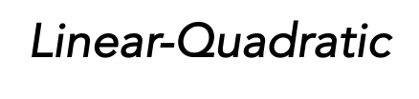




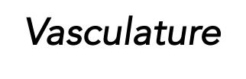
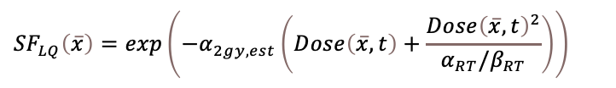
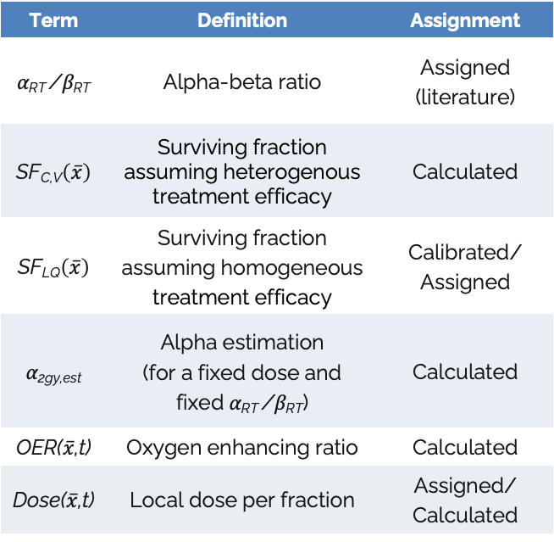
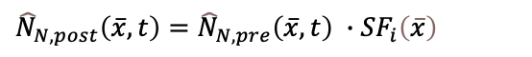
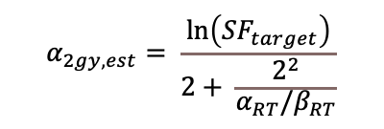
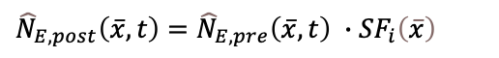
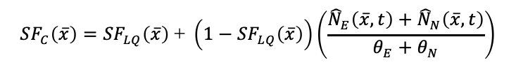
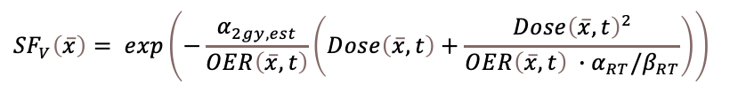
Methods
We simulated tumor growth and RT for each patient assuming treatment efficacy varies homogeneously (globally) or heterogeneously
(as a function of vasculature and cell density).
Response to RT
Term | Definition | Assignment
α_{RT} /β_{RT} | Alpha-beta ratio | Assigned (literature)
SF_{C,V}$\left(\overline{x}\right)$ | Surviving fraction assuming heterogenous treatment efficacy | Calculated
SF_{LQ}$\left(\overline{x}\right)$ | Surviving fraction assuming homogeneous treatment efficacy | Calibrated/ Assigned
α_{2gy,est} | Alpha estimation (for a fixed dose and fixed α_{RT} /β_{RT}) | Calculated
OER($\overline{x}$,t) | Oxygen enhancing ratio | Calculated
Dose($\overline{x}$,t) | Local dose per fraction | Assigned/ Calculated
${\hat{N}}_{E,post}\left(\overline{x},t\right)={\hat{N}}_{E,pre}\left(\overline{x},t\right) ∙{SF}_{i}\left(\overline{x}\right)$
and
${\hat{N}}_{N,post}\left(\overline{x},t\right)={\hat{N}}_{N,pre}\left(\overline{x},t\right) ∙{SF}_{i}\left(\overline{x}\right)$
Three scenarios to vary RT efficacy
$${SF}_{LQ}\left(\overline{x}\right)=exp\left(−α_{2gy,est}\left(Dose\left(\overline{x},t\right)+\frac{{Dose\left(\overline{x},t\right)}^{2}}{α_{RT}{/β}_{RT}}\right)\right)$$
$${SF}_{C}\left(\overline{x}\right)={SF}_{LQ}\left(\overline{x}\right)\text{ + }\left(1−{SF}_{LQ}\left(\overline{x}\right)\right)\left(\frac{{\hat{N}}_{E}\left(\overline{x},t\right)+{\hat{N}}_{N}\left(\overline{x},t\right)}{θ_{E}+θ_{N}}\right)$$
$$α_{2gy,est}= \frac{ln\left({SF}_{target}\right)}{2+ \frac{2^{2}}{α_{RT}{/β}_{RT}}}$$
$${SF}_{V}\left(\overline{x}\right)= exp\left(−\frac{α_{2gy,est}}{OER\left(\overline{x},t\right)}\left(Dose\left(\overline{x},t\right)+\frac{{Dose\left(\overline{x},t\right)}^{2}}{OER\left(\overline{x},t\right) ∙α_{RT}{/β}_{RT}}\right)\right)$$
Hormuth et al. Sci Rep 11, 8520, 2021
Notes:
We used contrast distribution (and $OER\left(\overline{x},t\right)$) as a surrogate for oxygen levels as some studies have linked contrast enhancement ratios to tissue hypoxia.
FMISO-PET is a type of medical imaging technique that uses the 18F-fluoromisonidazole (FMISO) radioactive tracer to detect and quantify tumor hypoxia (low oxygen levels) in living tissues.
Works by binding to and becoming trapped in hypoxic cells, providing a visual map of oxygen-deprived regions
Positron emission tomography (PET) detects the radioactive signals emitted by the trapped tracer
Rockne et al. (2015) used FMISO-PET to identify hypoxic voxels via thresholding of Tumor-to-Blood (T/B) ratio for binary classification of voxel: OER = to either 1 or 3

Slide 25
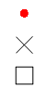
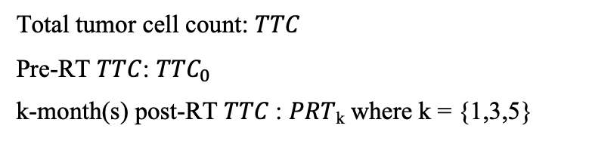
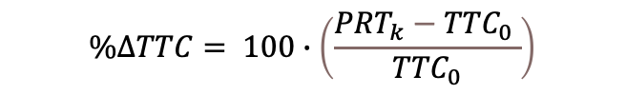
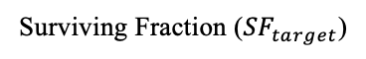
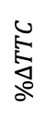
(A) Predictions 1-month post-RT with SOC dose
Patient 2
Tumor cell count increased by X%
$$\%∆TTC= 100∙\left(\frac{{PRT}_{k}{− TTC}_{0} }{{TTC}_{0}}\right)$$
Tumor cell count
decreased by X%
$$\%∆TTC$$
Total tumor cell count: $TTC$
Pre-RT $TTC$: ${TTC}_{0}$
k-month(s) post-RT $TTC$: $PRT$_{k} where k = {1,3,5}
M_{H}
M_{V}
M_{CD}
Surviving Fraction (${SF}_{target}$)

Slide 26
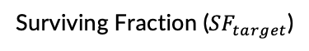
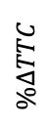
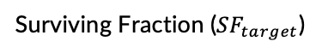



(A) Predictions 1-month post-RT with SOC dose
Patient 2
Patient 9
Patient 6
$$\%∆TTC$$
M_{H}
M_{V}
M_{CD}
Surviving Fraction (${SF}_{target}$)
Surviving Fraction (${SF}_{target}$)
Surviving Fraction (${SF}_{target}$)
(B) Predictions 1-month post-RT with personalized dose
Patient 2
Patient 9
Patient 6
$$\%∆TTC$$
M_{H}
M_{V}
M_{CD}
Surviving Fraction (${SF}_{target}$)
Surviving Fraction (${SF}_{target}$)
Surviving Fraction (${SF}_{target}$)

Slide 27



Notes:
Patient 2; SF_target = 0.89

Slide 28




Model predictions for the cohort
Heterogeneous RT efficacy model predictions 1 month post-RT with personalized dose:
(A)
(B)
${\text{M}}_{\text{V}\text{,}pers}^{\%∆TTC}$– ${\text{M}}_{\text{V}\text{,}SOC}^{\%∆TTC}$
${\text{M}}_{\text{CD}\text{,}pers}^{\%∆TTC}$– ${\text{M}}_{\text{CD}\text{,}SOC}^{\%∆TTC}$
Surviving Fraction (${SF}_{target}$)
Surviving Fraction (${SF}_{target}$)

Slide 29
Dose personalization
(for heterogeneous RT efficacy models only)

Slide 30


Calculating spatial dose boost Use CTV as domain for dose boost calculation
GTV: gross tumor volume
CTV: clinical target volume
PTV: planning target volume
Goal: Expand GTV by uniform distance (1.5 cm) in all directions (3D) to account for infiltrative disease
(enh. region)
(non enh. region)
Notes:
GTV (Gross Tumor Volume):
This is the visible tumor seen on imaging (like MRI). In post-operative glioblastoma, it often refers to the resection cavity and any remaining enhancing tumor.
CTV (Clinical Target Volume):
This volume is larger than the GTV and includes the GTV plus a margin to encompass potential microscopic spread of cancer cells beyond the visible tumor. The exact margin added can vary, but it's intended to ensure that all potentially cancerous tissue receives radiation
PTV (Planning Target Volume):
This is the largest volume, created by adding a margin to the CTV. This margin accounts for:
Patient movement: Small movements during treatment can shift the tumor position.
Setup uncertainties: Slight variations in how the patient is positioned for each treatment session.
Internal organ motion: Organs can shift slightly during treatment.
Beam penumbra: The edge of the radiation beam isn't perfectly sharp and can spread slightly.
Dose buildup: The radiation dose needs a certain distance to build up to its full strength

Slide 31
Personalized dose maps
CTV: Clinical Target Volume
Dose boost within CTV
SOC outside of CTV
Personalized dose map
0
4.30
Gy/fraction
Patient 4, central tumor slice, SF_{target} = 0.86, M_{V}

Slide 32
Dose map comparison
Homogeneous model: M_{H}
Heterogeneous, Vasculature model: M_{V}
Heterogeneous, Cell density model: M_{CD}
M_{H}
M_{V}
M_{CD}
Cumulative dose-volume histogram
Dose maps
Fraction of volume
5.8
3.8
Dose map differences
Gy/fraction
(M_{V} – M_{H})
0
0
(M_{V} – M_{CD})
Dose (Gy/fraction)
Patient 10, central tumor slice, SF_{target} = 0.86
Notes:
Patient 10
DVH is calculated for wherever there is nonzero dose (so basically whole brain almost)
Baseline CTV
Average dose across all fractions
(where MV adds dose that MH,CD don’t)

Slide 33
Cohort dose comparison
(A)
(B)
D_{max} in CTV (Gy/fraction)
D_{mean} in CTV (Gy/fraction)
M_{H}
M_{V}
M_{CD}
M_{H}
M_{V}
M_{CD}
Notes:
Each bar represents the entire cohort
Average across all fractions
Central tumor slice
Baseline CTV
Key: even though the mean is pretty much the same across all three models-- some voxels require way more dose than others according to the Dmax plot for Mv and Mcd

Slide 34
Summary
Determined how different assumptions of heterogeneity in RT efficacy influence predictions of response and calculated dose boost maps to compensate for these differences.

Slide 35

Questions for you & Next Steps
Working on a manuscript over this study
Transitioning to the adaptive RT dataset:
Implement a formal dose optimal control problem that minimizes tumor cell count at 1-m post-RT subject to clinical dose and hardware constraints
Quantify toxicity for organs given different fractionation scheme

Slide 36


Acknowledgements
Thomas Yankeelov
David Hormuth
Caroline Chung
Bikash Panthi
Sara Thrower
Maguy Farhat
Brandon Curl
Holly Langshaw
Andrew Elliot
Karine Al Feghali
Funding
CPRIT: RR160005, RP220225
NIH: U01CA142565, U01CA174706, U01CA186193, R01CA138599, R21CA169387
Oncological Data and Computational Sciences 2020-21 Pilot Project

Slide 37

Cell density (CD) model
Maximum possible cell kill without any CD effects (i.e. min possible SF)
Aggression factor that increases with CD
$$SF\left(\overline{x}\right)={SF}_{RT}\left(\overline{x}\right)\text{ + }\left(1−{SF}_{RT}\left(\overline{x}\right)\right)\left(\frac{{\hat{N}}_{E}\left(\overline{x},t\right)+{\hat{N}}_{N}\left(\overline{x},t\right)}{θ_{E}+θ_{N}}\right)$$
If N is close to carrying capacity → contribution of proliferation term in PDE decreases (think logistic growth)
→ SF decreases
Notes:
We assumed that regions with a tumor cell density nearing the carrying capacity inhibit proliferation, which in turn reduces the likelihood of tumor cell death due to mitotic catastrophe.

Slide 38


OER map calculation
$$OER\left(\overline{x},t\right)= max\left(ER\left(\overline{x},t\right)\right)−ER\left(\overline{x},t\right)+1$$
Think of ER like:
brightness = oxygenation
$ER(\overline{x},t)$ is the voxel-wise enhancement ratio between the post- and pre-contrast T₁-weighted images.
We used the $OER\left(\overline{x},t\right)$as a surrogate for oxygen levels as some studies have linked contrast enhancement to tissue hypoxia.
Notes:
This measures how much the voxel brightens after contrast injection
High ER → strong contrast enhancement → high perfusion or leaky vasculature, sometimes correlated with better oxygenation.
Low ER → weak enhancement → poor perfusion, possibly more hypoxic.
The + 1 keeps the minimum OER = 1

Slide 39

DNA damage induced by radiation

Slide 40
The basics: how radiation damages cells
When ionizing radiation (like X-rays) passes through tissue, it deposits energy that causes ionizations (removing an electron) of atoms and molecules.
There are two broad types of DNA damage:
Direct effect: Radiation hits DNA directly → ejects an electron → creates a DNA radical → breaks bonds, changes bases, etc.
Indirect effect: Radiation hits water in the cell → this causes radiolysis of water → most often, hydroxyl free radical will bond with DNA backbone or bases

Slide 41

Water radiolysis
Radiation hits water, which makes up ~70% of the cell → this causes radiolysis of water (not hydrolysis — “radiolysis” = bond breaking by radiation).

Slide 42

Where oxygen (O₂) comes in
When a radical is formed on DNA (due to direct or indirect ionization), that damaged site can sometimes be repaired by the cell if it remains a “reducible” radical. (It’s a transient chemical change that can be reversed by cellular reducing agents.)
However, if oxygen is present, it can react with the DNA radical to form a peroxyl radical (ROO•):
The above product is non-repairable — the damage becomes “fixed” or permanent. That’s why oxygen enhances radiation damage!
This explains why cells are less radiosensitive in the absence of oxygen (hypoxia)

Slide 43



Dose calculation math review
$Aβ=10$ Gy
Solve for 𝛼_{2gy,est} given SF_{target} (scalar, assigned)
SF_{RT} (scalar, global): The surviving fraction after a standard dose (2 Gy everywhere).
Desired biological dose effect – this is our target!
Result: single, ideal radiosensitivity value
We will call this SF_{orig}
$$α_{2gy,est}= \frac{ln\left({SF}_{target}\right)}{2+ \frac{2^{2}}{α_{RT}{/β}_{RT}}}$$
Convert SF_{RT} to the 2 Gy equivalent of alpha, given $Dose(\overline{x},t)$
SF_{RT} (local map): expected surviving fraction from the SOC map, assuming no resistance due to intratumoral heterogeneity
Planned physical dose effect
Notes:
Target: "I don't care what the original dose was supposed to be. My goal is for every single cancer cell, no matter where it is, to be killed with the same high level of efficiency—the efficiency of our 2 Gy benchmark."

Slide 44



Dose calculation math review
$Aβ=10$ Gy
From last slide…
SF_{RT} (local map): expected surviving fraction from the SOC map, assuming no resistance due to intratumoral heterogeneity
Solve for $SF(\overline{x},t)$ given updated SF_{RT}
CD
SF(x,t) (local map): realistic outcome of a standard dose
Highlights resistant areas
or
Vasc.

Slide 45

Dose calculation math review
$Aβ=10$ Gy
From last slide…
CD
SF(x,t) (local map): realistic outcome of a standard dose
or
Vasc.
Solve for 𝛼_{calc}
𝛼_{calc} (local map): new map of local resistance
Quantifies biological resistant areas
,cd

Slide 46

Dose calculation math review
$Aβ=10$ Gy
From last slide
𝛼_{calc} (local map): new map of local resistance
,cd
Solve for personalized dose boost
Dose (local map): calculate the extra dose needed to overcome its specific local resistance
Achieve ideal desired biological dose effect
SF_{orig}
,cd

Slide 47


Dose calculation summary
$Aβ=10$ Gy
Solve for 𝛼_{2gy,est} given SF_{target} (scalar, assigned)
Convert SF_{RT} to the 2 Gy equivalent of alpha, given $Dose(\overline{x},t)$
$$α_{2gy,est}= \frac{ln\left({SF}_{target}\right)}{2+ \frac{2^{2}}{α_{RT}{/β}_{RT}}}$$
Solve for 𝛼_{calc}
Solve for $SF(\overline{x},t)$ given updated SF_{RT}
CD
,cd
or
Vasc.
Solve for personalized dose boost
SF_{target}
,cd

Slide 48
AIC model selection using Akaike Weights
Wagenmakers and Farrell
Introduction
What’s the problem?
Traditional model selection methods usually pick a single “best” model, say M1. However, they don’t quantify how much better M1 is compared to the others in the family.
Why is this important?
We need to quantify uncertainty in model selection and avoid overconfidence in a single model.
What do the authors contribute?
Using Akaike weights derived from AIC to provide a probabilistic interpretation of each model’s quality.

Slide 49

AIC model selection using Akaike Weights
Wagenmakers and Farrell
Background on Akaike Information Criterion (AIC)
What is AIC?
A metric to compare models in a family that balances goodness-of-fit and complexity (number of parameters).
$${AIC}_{i}=−2\log{L_{i}}+2V_{i}$$
Log-likelihood
of the model
Number of parameters
Notes:
Li = maximum likelihood for the candidate model i
Vi = free / estimate parameterds

Slide 50

AIC model selection using Akaike Weights
Wagenmakers and Farrell
Background on likelihood
What even is “likelihood”?
Likelihood tells us how well a model explains the data we observed.
It answers: “If this model were true, how likely is it that we would have seen this data?”
How does this factor into model fit?
Higher likelihood = the model fits the data better (the observed data is more acceptable under this model).
$$L_{i}=P(data|model)$$
Notes:
Li = maximum likelihood for the candidate model i
Vi = free / estimate parameterds

Slide 51


AIC model selection using Akaike Weights
Wagenmakers and Farrell
Background on Akaike Information Criterion (AIC)
Why the $−2\log{L_{i}}$?
Logs make math easier (turn products into sums)
The negative sign lets us minimize positive values
The factor of 2 makes results comparable to standard statistical tests (Chi-square)
$$\log\left(L_{i}\right)=\log\left(P\left(x_{1}\right)∙P\left(x_{2}\right)∙∙∙P\left(x_{n}\right)\right)$$
$=\log\left(P\left(x_{1}\right)\right)+…+\log\left(P\left(x_{n}\right)\right)$
Notes:
Li = maximum likelihood for the candidate model i
Vi = free / estimate parameterds

Slide 52

AIC model selection using Akaike Weights
Wagenmakers and Farrell
Background on Akaike Information Criterion (AIC)
Interpretation of AIC:
Lowest AIC = best model in the family
Models with more parameters must produce substantially better fit to be preferred.
Problem:
Just looking at the lowest AIC doesn’t say how much better it is compared to others. We are interested in relative performance, too.
$${AIC}_{i}=−2\log{L_{i}}+2V_{i}$$

Slide 53
AIC model selection using Akaike Weights
Wagenmakers and Farrell
From AIC Differences to Akaike Weights
What if we could convert raw AIC values into a continuous, probability-based measure that shows how likely each model is to be the best among the candidates? → The answer?: Akaike weights
What do Akaike weights describe?
They are the (normalized) probability that each model is the best given the data and model family.
It’s like saying: "There’s a 70% chance this model is the best, and 30% chance another one is the best."

Slide 54



AIC model selection using Akaike Weights
Wagenmakers and Farrell
From AIC Differences to Akaike Weights (calculation)
Compute AIC differences ($∆_{i}$):
How much worse model i is compared to the best model
Compute relative likelihood:
Likelihood theory: If two models differ by $∆_{i}\left(AIC\right)$, then their likelihood ratio is approximately:
$$∆_{i}\left(AIC\right)= {AIC}_{i}−min⁡(AIC)$$
$$\frac{L_{i}}{L_{best}}=exp\left\{−\frac{1}{2}∆_{i}\left(AIC\right)\right\}$$
Notes:
Probabilistic meaning:
Weights sum to 1, making them interpretable as model probabilities.

Slide 55




AIC model selection using Akaike Weights
Wagenmakers and Farrell
From AIC Differences to Akaike Weights (calculation)
Normalize to get Akaike weights:
Turn the relative likelihoods into probabilities (sum to 1)
$w_{i}$​ tells us the probability that model i is the best model (given the data and model set)
$$w_{i}\left(AIC\right)=\frac{exp\left\{−\frac{1}{2}∆_{i}\left(AIC\right)\right\}}{\sum_{k=1}^{K}{exp\left\{−\frac{1}{2}∆_{k}\left(AIC\right)\right\}}}$$
$$w_{i}∈ \left[0,1\right]$$
$$\sum_{i}{w_{i}}=1$$

Slide 56
Model selection
AIC
AICc_eqn = @(n, RSS, p) 2*p + n*log(RSS/n) + (2*p*(p+1)) / (n-p-1);
n = size(Na_true, 4); % how many time points for fit
RSS = sum((Nb_true-Nb_m).^2, 'all');
p = sum(del_check); % total number of fitted parameters across all voxels
Notes:
matlabFunction or the symbolic engine internally simplifies expressions.
If MATLAB assumes n < p + 1, then n - p - 1 becomes negative, and it may pull a negative sign out and move it to the numerator.

Slide 57




Model selection
Patient | AIC-weights
 | M_{H} | M_{V} | M_{CD}
1 | 0.28 | 0.24 | 0.48
2 | 0.50 | 0.25 | 0.26
3 | 0.49 | 0.41 | 0.10
4 | 0.50 | 0.32 | 0.18
5 | 0.77 | 0.07 | 0.16
6 | 0.07 | 0.13 | 0.80
7 | 0.61 | 0.24 | 0.16
8 | 0.95 | 0.05 | 0.00
9 | 0.00 | 0.86 | 0.14
Based on highest Akaike weights
Akaike weights ($w_{i}$)​ tells us the probability that model i is the best model (given the data and model set)
$$w_{i}\left(AIC\right)=\frac{exp\left\{−\frac{1}{2}∆_{i}\left(AIC\right)\right\}}{\sum_{k=1}^{K}{exp\left\{−\frac{1}{2}∆_{k}\left(AIC\right)\right\}}}$$
$$w_{i}∈(0, 1)$$
$$\sum_{i}{w_{i}}=1$$
Notes:
w_{i} are the (normalized) probability that each model is the best given the data and model family.
It’s like saying: "There’s a 70% chance this model is the best, and 30% chance another one is the best."

Slide 58
*Calibrated
Global to local parameter mapping system
mv mapping system is a way to handle two types of model parameters: global and local
The mv_* variables (mv, mv_2, mv_3, etc.) are integers that can be defined for X number of voxels.
IMPORTANT: Params 1, 6, 10, 18, & 19 are all designed to be locally-varying parameters (since they all use this mv_* framework). All other params could be single, global values or single, global values defined on a “local” scale over a region via a mask.
Variable | Controls expansion of … | Parameter description
mv | Parameter 1 | Nb proliferation rate (kp,b)
mv_2 | Parameter 6 | Nb carrying capacity
mv_3 | Parameter 10 | Na proliferation scaling
mv_4 | Parameter 18 | SF_other (chemo outside RT)
mv_5 | Parameter 19 | Nc death rate

Slide 59
*Calibrated
Model parameters
Global Param | Description | Locally varying? | Mapping via (mv_*)?
1 | Nb proliferation rate (kp,b) | yes | mv values
2 | Nb diffusion (gray matter) | no (applied via masking?) | None (1-to-1)
3 | Nb diffusion (white matter) | no (applied via masking?) | None (1-to-1)
4 | Nc diffusion scaling (NOT USED) | no | None (1-to-1)
5 | theta_min (min theta for dyn. CC model) | no | None (1-to-1)
6 | Nb carrying capacity | no | None (1-to-1)
7 | Na diffusion scaling (Scaling factor for diffusion coefficient Da = params_e(7)*Db) | no (applied via masking?) | None (1-to-1)
8 | RT_long (effect of RT) | no (applied via masking?) | None (1-to-1)
9 | Mechanical coupling (in von mises term) | no | None (1-to-1)
10 | Na proliferation scaling | no (masking?) | None (1-to-1)

Slide 60
*Calibrated
Model parameters
Global Param | Description | Locally varying? | Expansion (mv_*)
11 | Nc proliferation scaling (NOT USED) | no | None (1-to-1)
12 | Na carrying capacity | no | None (1-to-1)
13 | Na/Nb competition (a on b) | no | None (1-to-1)
14 | Na/Nb competition (b on a) | no | None (1-to-1)
15 | Nc carrying capacity (NOT USED) | no | None (1-to-1)
16 | SF_rt (surviving fraction to RT) | no (mask) | None (1-to-1)
17 | alpha/beta ratio (beta_rad) | no | None (1-to-1)
18 | SF_other (chemo outside RT) | no (mask) | None (1-to-1)
19 | Nc death rate (NOT USED) | no | None (1-to-1)
20 | (NOT USED) | ? | None (1-to-1)
21 | (NOT USED) | ? | None (1-to-1)
22 | SF_ct (chemo during RT) | no (mask) | None (1-to-1)

